Slide 1




What do we need? Inclusive Innovation! Where do we need it?
An evaluation of regional demand & supply for inclusive innovation
MaRS x MIT
Notes:
Intro – our names, roles, today’s research

Slide 2
What are we doing and why?
We want to know…
In order to…
Regional demand for inclusive innovation - Which regions around the world have the lowest rates of financial inclusion, technology access, skills development and opportunity matching, and income growth and job creation?
Regional supply of inclusive innovation – Where are the companies that aim to address each of these barriers to inclusion in the digital economy located around the world?
Identify potential markets for applicants to the MIT Global Inclusive Innovation Challenge (IIC)
Identify countries that would benefit from incentivizing inclusive innovation (through targeted outreach by the IIC, other international efforts, local governments, etc.)
Notes:
The IIC recognizes and supports young companies around the world that are working in four areas of inclusive innovation so that the world’s lowest means populations can participate in and prosper from the digital economy.
Our research aims to measure the regional demand and supply for this type of inclusive innovation in order to identify unmet needs for solutions in each of the four IIC categories.
This information can:
help identify potential markets for IIC applicants, like the companies pitching here today, and can
Identify countries around the world that would benefit from further incentivizing inclusive innovation (e.g. by more targeted outreach from the IIC in future years)

Slide 3


Measuring Demand for Inclusive Inovation
Case study: Financial Inclusion

Slide 4
How do you measure demand for inclusive innovation?
We rank countries around the world using scores for Financial Inclusion, Technology Access, Income Growth and Job Creation, and Skills Development and Opportunity Matching to identify low scoring regions, where demand for inclusive innovation is high.
We develop the scores by applying data from international organizations (World Bank, International Labor Organization, World Economic Forum, OECD) to established frameworks.
Example: measuring financial inclusion using the G20 financial inclusion indicators framework
Underlying Factors
Dimension Scores
Financial Inclusion Score
(e.g. ATMs per 100,000 people, percentage of population with bank account)
Access
Usage
Quality
Notes:
So how do we measure the demand for inclusive innovation?
We calculate country-level scores for each of the four IIC categories – Financial Inclusion, Technology Access, Skills Development & Opportunity Matching, and Income Growth & Job Creation. As we proceed we’ll use Financial Inclusion as an example to illustrate our methodology.
We develop these category scores by aggregating data on a variety of underlying factors
The frameworks we use are based off frameworks developed by various international organizations. For financial inclusion, we use the G20 Financial Inclusion Indicators framework, which considers factors related to three dimensions of financial inclusion – the access, usage, and quality of financial services in a given country
The data about these underlying factors also come from various international organizations. For financial inclusion, data comes from the World Bank, and the factors include things like ATMs per 100,000 people (under access), and the percentage of the population with a bank account (under usage)
[Quality – barriers, financial literacy, consumer protection (access to credit, dispute resolution score, main source of emergency funds = savings)]

Slide 5
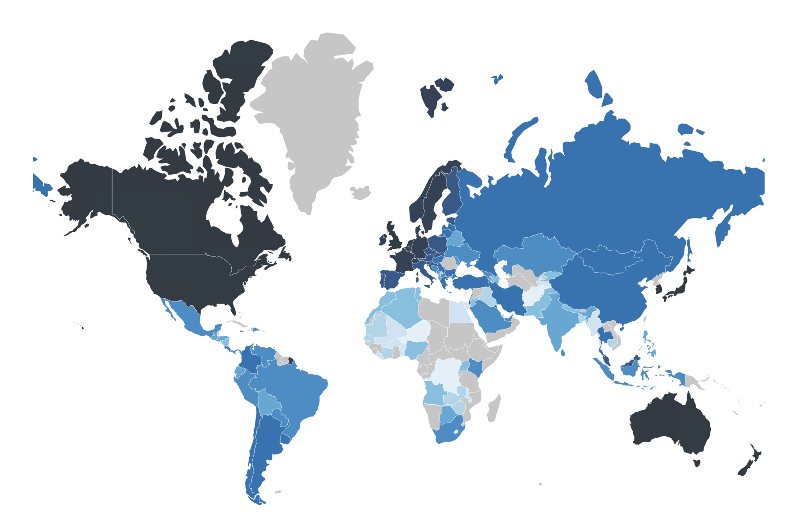
Financial Inclusion Index
No Data
0
50
100
Notes:
Using our scores, we map the demand for inclusive innovation in each category
Here is the map for financial inclusion. It provides us with a clear visual of the regions that most in need of inclusive innovation in financial services. Most African countries, for instance, have low financial inclusion scores, as well as parts of central, south, and southeast Asia. Many people in these areas don’t use traditional financial services like deposit accounts, or digital payments, partly because they have limited access to banks and even basic services like Internet.

Slide 6
Takeaways - Demand for inclusive innovation in Canada and the United States
The high cost of cell phone plans in Canada poses a barrier to technology-based services for many Canadians
High tuition costs in the United States prevent low-income Americans from getting a post-secondary education
As the digitization of the economy contributes to rising income inequality in Canada and the United States it renders some career paths unsustainable, creating a class of vulnerable workers with uncertain future incomes
Notes:
Turning towards Canada and the US, financial inclusion is less of a pressing issue in terms of traditional financial services
However, there are other barriers to inclusion in the digital economy, and we’ll discuss a few that relate to Technology Access, Skills Development, and Income Growth.
For example:
In Canada, the high costs of owning cell phones and subscribing to cellular data prevent low-means individuals from accessing certain mobile-based services
In the United States, high tuition costs limit access to post secondary education for those who can’t afford it
In both countries, the digitization of work contributes to rising income inequality which excludes a class of workers from sharing in the prosperity of the digital economy

Slide 7


Evaluating Supply of Inclusive Innovators
Case study continued: Financial Inclusion
Notes:
GOAL: quantify the organizations around the world are working to build solutions in the 4 challenge areas as well as to understand where these organizations are located.
We hope that this will help identify countries that could benefit from incentivizing inclusive innovation either through targeted outreach by the IIC, local governments or other international efforts.

Slide 8
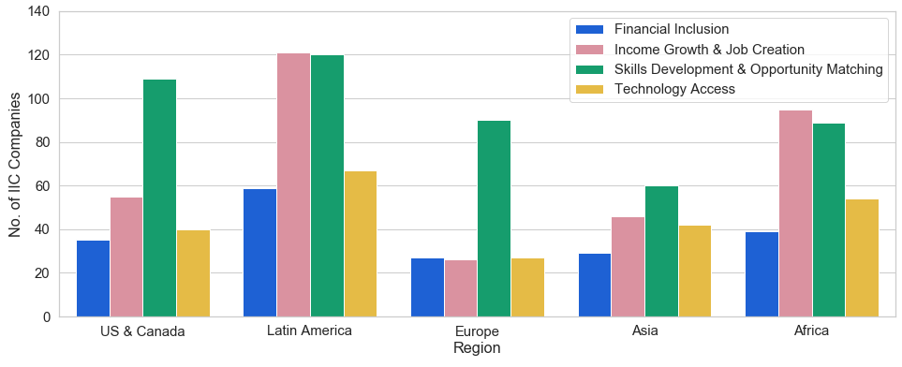
Regional Supply of IIC Applicants (2017-2019) by Category
Our analysis included 1230 applicants representing each region and category
15.4% (or 189) are financial inclusion ventures
NOTE: In 2017, the challenge was only open to US & Canada, therefore the US & Canada region may be over represented. Further, the most recent year was considered for applicants that applied in multiple years
Notes:
Let’s begin by understanding the supply of inclusive innovators captured by challenge. We looked at 1230 IIC applicants from 2017 to 2019.
We can see that Latin America had proportionally more innovators than the other regions. We can also see that Skills Development and Opportunity Matching was the most popular award category in most regions except Africa and Latin America, where it was slightly surpassed by Income Growth & Job creation.
By capturing the supply of companies addressing the 4 challenge areas we hope to identify which countries could benefit most from innovative solutions.
We’ll continue to focus on the Financial Inclusion category to illustrate how we went about this. Financial Inclusion represented 15% of the applicants included in our analysis or 189 applicants.

Slide 9
Financial Inclusion Index
No Data
0
50
100
Notes:
Let’s take a look at the geographical distribution of these companies over the demand map.
As applicants were encouraged to select a region where their work is having the greatest impact, this map is able to show where solutions are being applied.
For example, a company that is based in Amsterdam but is working to address Financial Inclusion in Kenya would appear as a dot in Kenya on the map.

Slide 10
Identifying non-applicant Financial Inclusion companies
Solution:
Use descriptions of the Financial Inclusion applicants to identify the key words defining the category.
Financial
Craft
Fintech
Financial Institution
Help
people
Financial Service
High-yield investment
Social impact
Lender
Debt
Start-up
Financial Product
Saving
Inclusive
Credit
Bank
Social good
Lending
Artisan
Online payments
Impact
Wallet
Innovation
Payment
Notes:
How can we identify companies that did not apply to the challenge but are addressing problems in financial inclusion.
Using company descriptions taken from either Crunchbase, Linkedin, the company’s website or the text fields from the IIC applications, we can begin to identify the key words that define the category.
Comparing the descriptions of companies under financial inclusion in contrast with companies in the other award categories allows us to further refine these words so that we can better identify the words that are most telling of belonging to Financial Inclusion.

Slide 11
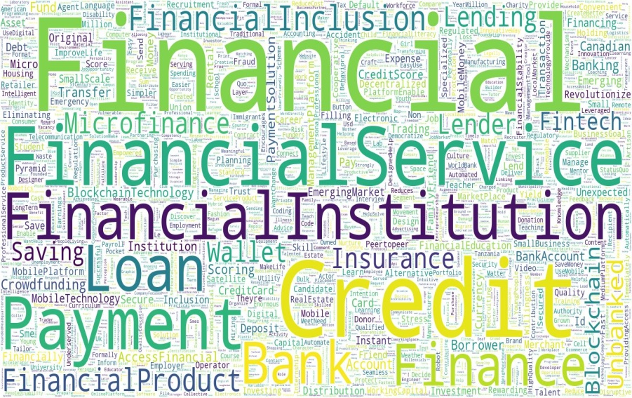

Identifying non-applicant Financial Inclusion companies
Solution:
Use descriptions of the Financial Inclusion applicants to identify the key words defining the category.
See if non-applicant companies describe themselves in similar ways.
$$f._{\begin{aligned}financial inclusion \\ classifier\end{aligned}}.\left(\begin{aligned} company \\ description\end{aligned}\right)= yes or no$$
Example: Paylater, Nigeria
Paylater is a digital financial services platform that specializes in consumer lending. They empower individuals with access to credit, simple payments solutions, high-yield investment opportunities and easy-to-use tools for personal financial management …
Notes:
In this word cloud are the words financial inclusion companies used to describe themselves. The size of the word corresponds to how strong an indicator that word is of belonging to the category. For example, the presence of words such as Financial, Financial Service, Credit, Loan, Payment in a company’s description are the strong indicators of belonging to the financial inclusion category.
Using the descriptions of Financial Inclusion applicants, we then trained a classification model that would take the text description of a company as input and return a yes if the model thought it was a Financial Inclusion company or otherwise, return a no.
For example, Paylater is a company that did not apply to the IIC but was classified as addressing Financial Inclusion. Looking at Paylater’s description, we can see that there is a lot of overlap between the words in their description and the words in the word cloud.

Slide 12
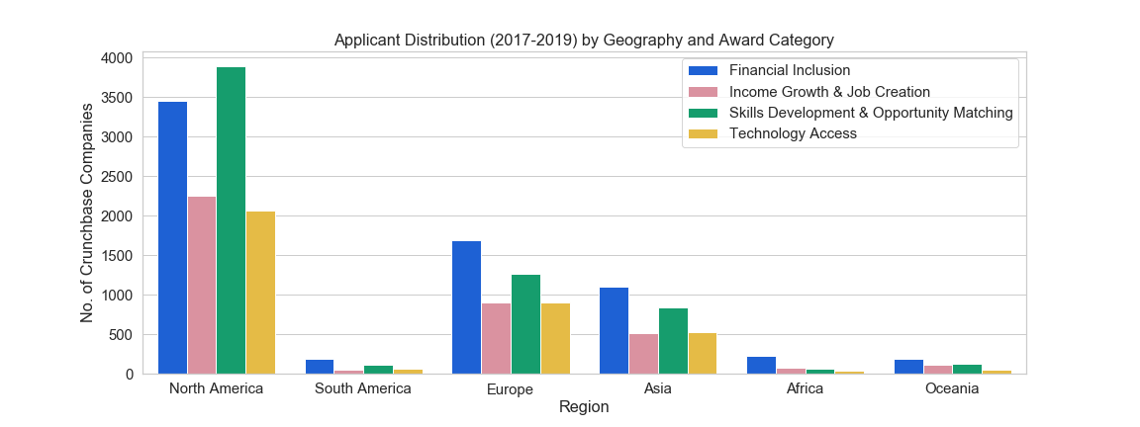
Results: Global Supply of Inclusive Innovators
Crunchbase as global dataset of innovative companies, with 410k+ companies
5% (or 20.6K) of these were identified as addressing problems in the 4 challenge areas
Of this 5%, 33% (or 6.8K) were identified as addressing problems in financial inclusion
NOTE: Crunchbase companies were mapped to their continents instead of the Regions defined by the challenge. Also note that all non-English Crunchbase entries were removed.
Notes:
We built 4 classification models for each challenge area.
We used Crunchbase as our global database of innovative companies and applied our models to the 410k+ companies.
Using our models, we identified 5% of the Crunchbase companies as addressing problems in the 4 challenge areas.
Of this 5%, 33% were identified as addressing problems in financial inclusion.
While there appears to be significantly more activity in North America compared to the other regions, we should note that this could be a result of only looking at the English entries in Crunchbase.
It is also possible that Crunchbase may not be the best representation of companies in other continents.
NOTE: Only included predict proba values > 0.75
20665 CB inclusive innovators
6831 CB Fin Inc

Slide 13
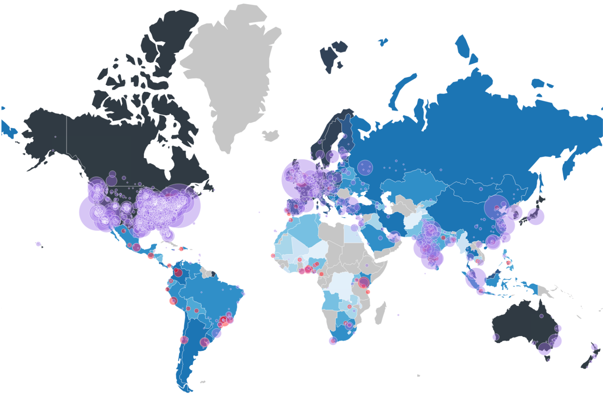
Financial Inclusion Index
No Data
0
50
100
Notes:
Let’s now add this layer of companies identified as Financial Inclusion to our map.
Note that these dots represent where companies are based, not necessarily where their solutions are being applied. We did not have the data to capture the markets being served by these companies.
While it is difficult to paint a complete picture, we can start to get a sense of where there may be unmet demand - this being the light blue countries with the fewest dots. These regions could be potential markets for inclusive innovation and we now start to think about how to incentivize inclusive innovation in these areas.
We can also begin to look at the regions that are performing well to see what can be learned from the underlying structures or systems in place.

Slide 14
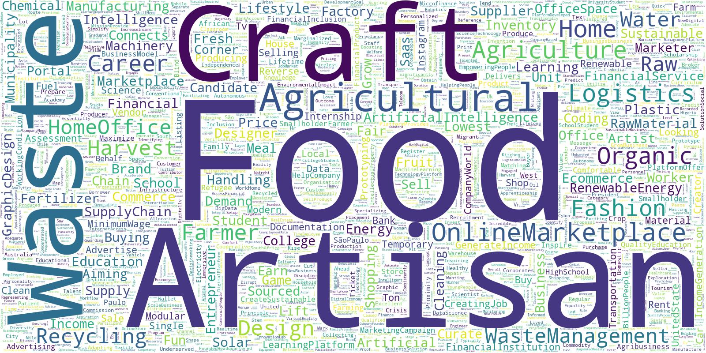
Limitations
Income Growth & Job Creation?
Notes:
So that was how we quantified the supply of financial inclusion companies. But when we tried to do this for other categories …
We found that there was a wide range of how companies describe themselves
For example, if we look at income growth and job creation, we can see words like Waste, Craft, Food, Artisan, Home Office and Online Marketplace used by companies under this category.
These words cast a large net therefore it proved to be difficult to identify which Crunchbase companies are building solutions within Income Growth and Job Creation. Asa will talk about an alternate approach we explored to overcome this challenge.

Slide 15




Considering alternative categories of inclusive innovation
Notes:
Asa will talk about an alternate approach we explored to overcome this challenge.

Slide 16
The problem...
Income Growth & Job Creation?
Forcing un-like companies into the same group limits our potential to identify similar companies around the world.
Can we identify more accurate categories based on the applicant descriptions?
Notes:
Recall one of our goals was to measure the regional supply of inclusive innovation.
In order to do this we need a clear picture of what an inclusively innovative company looks like – or rather, how it describes itself
We originally assumed that companies that apply to the same IIC category describe themselves similarly, but then realized this isn’t necessarily the case
This lead us to ask: are there other categories (or topics) that accurately capture the various types of companies that apply to the IIC?

Slide 17
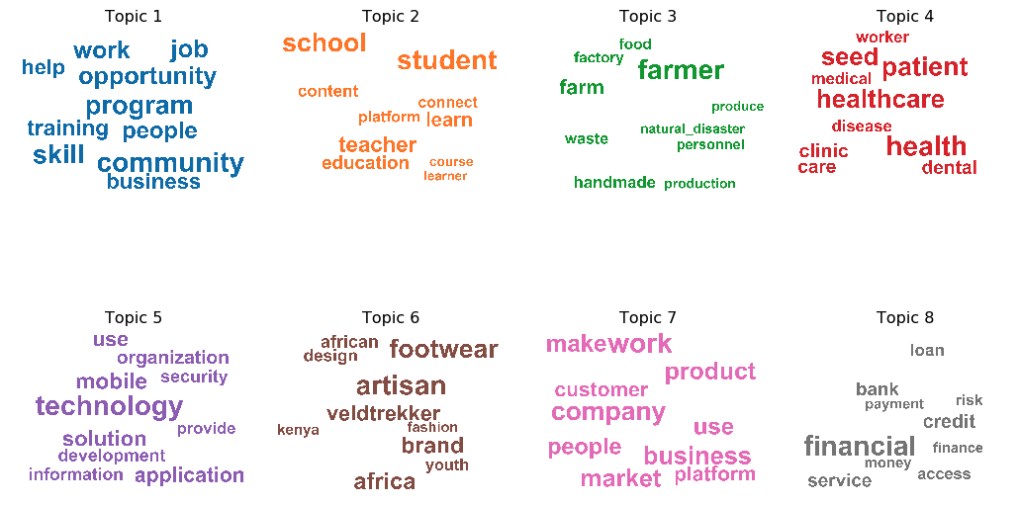
Our solution: identify companies using eight new topics
Notes:
To answer this question, we applied a topic modelling framework to the IIC applicant descriptions data
This allowed us to identify the themes (or topics) that characterize the IIC applicant pool, regardless of the four IIC categories
In doing this, we found eight topics within the dataset. Here are the most salient words in each topic.
One company description may contain several topics, and that a that a given word may arise in multiple topics
Using these topics, which emerge organically from the applicant descriptions rather than topics we attempt to impose based on the four IIC categories, we get a better idea of the non-applicant companies to look for when measuring the global supply of inclusive innovation
More accurately identifying these non-applicant can also help the IIC regional partners expand their outreach in future years

Slide 18
We can use these new topics to more accurately identify other (non-applicant) inclusive innovators around the world
Example: [work, job, help, opportunity, training, program, people, skill, community, business]
ThinkSquare, Toronto
“ThinkSquare is an AI-based career matching and optimized job search platform that provides a curated list of jobs personalized to individual skills, experience, and preferences.”
Example: [school, student, content, connect, learn, platform, connect, teacher, education, course, learner]
23 Code Street, London UK
“23 Code Street is a coding school for women.”
Notes:
Given our eight new topics, we can look for other companies that use those topics in their descriptions.
Here we have two examples of Crunchbase companies we identified using models that were trained on two of our new topics.
We identified the first, ThinkSquare as a company whose description contains the work, job ,help, opportunity topic. ThinkSquare is a career matching & job search platform.
We identified the second, 23 Code Street, as a company whose description contains the school, student, content topic. It is a coding school.
These initial results are promising, and suggest our new topics may allow us to more accurately measure the supply of inclusive innovators as we proceed with our research

Slide 19


Next Steps
Can we...
get a better sense of which markets companies serve?
get a more regionally representative dataset?
better identify truly inclusive innovators?
Notes:
We’ve quantified demand for inclusive innovation using established frameworks and international datasets and have measured the supply of inclusive innovators using 2 alternative methods
This gives us a starting point for understanding where there is unmet need for inclusive innovation however there is still room for improvement.
We’d like further this research by getting access to data that can help us understand which markets companies serve. We’d like to get data on regions that may be underrepresented in Crunchbase. We’d also like to expand our dataset to include both inclusive innovators and other companies to give us a sharper contrast of how inclusive innovators describe themselves.

Slide 20


Questions?

Slide 21


Thank You
Asa Motha-Pollock
amothapollock@marsdd.com
Upeksha Amarasinghe
uamarasinghe@marsdd.com

